Slide 1
ChemCorp Non-Technical Slide Deck
M. Tiras-2020

Slide 2
California by location, Paper, and Packaging by Industry and Chemical K by-product are the most profitable segments. Pharmaceutical and Medical Equipment have the lowest profitability.
Customer Strategy Overall | By Location (Most-Least) California (~$2,3M Profit)-North Dak.($31K) By Product (Most-Least) Chemical K (~$6M Profit)-Chemical A (~143K)
Market Opportunities | By Industry (Revenue) (Most-Least) Paper and Packaging (~$22M)-Pharmaceutical (~$3,5M) By Industry (Profit) (Most-Least) Paper and Packaging (~$12M)-Pharmaceutical ($2M)
Product Divestment (Lowest Profitability) | By Industry Pharmaceutical (~$2,1M) and Medical Equipment (~$2,2M) By Product Chemical A, J,C

Slide 3
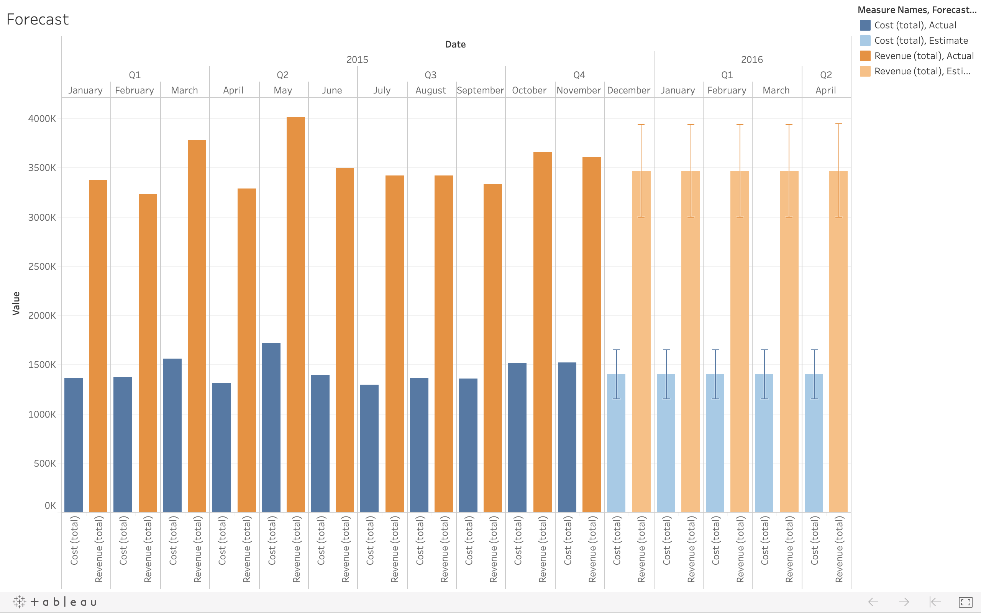
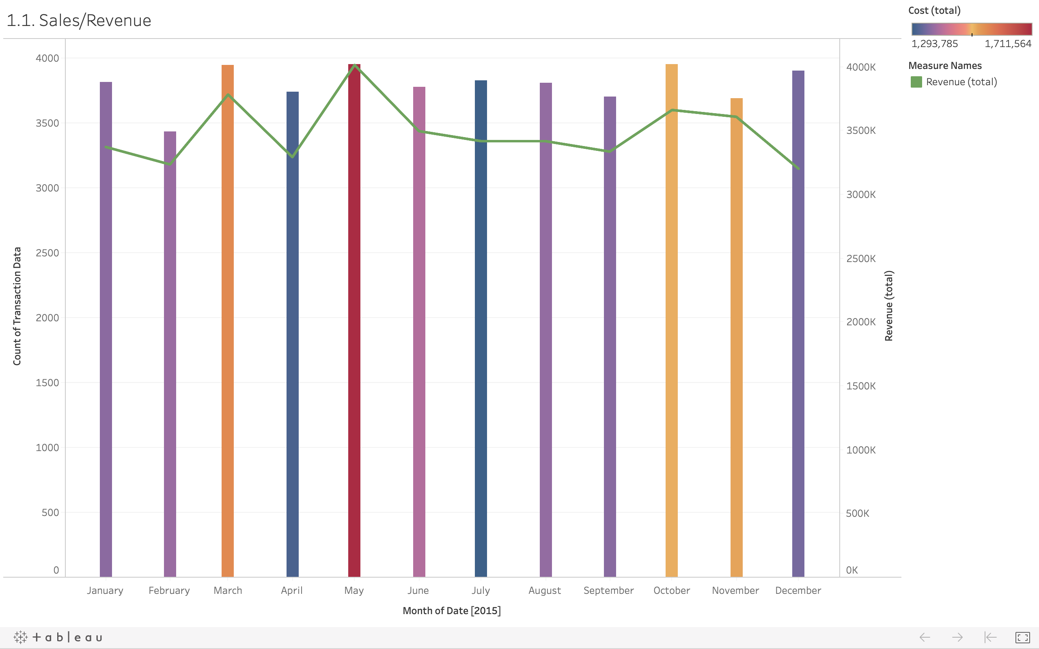
Both visual and statistical methodologies indicate that the cost variance must be focused on stopping market losing.

Slide 4
Company’s cost and revenue graphic in Tableau shows which months have the highest cost ratio.

Slide 5
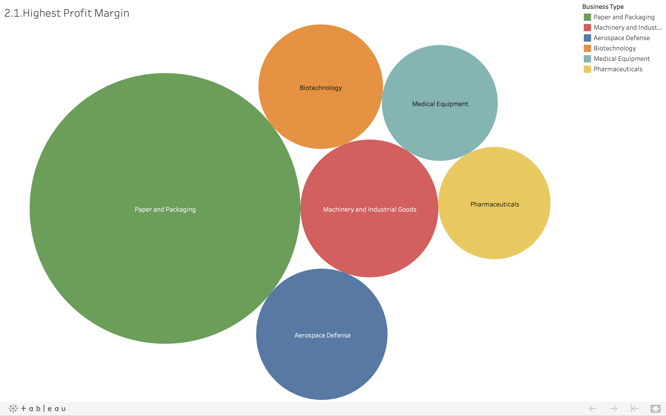
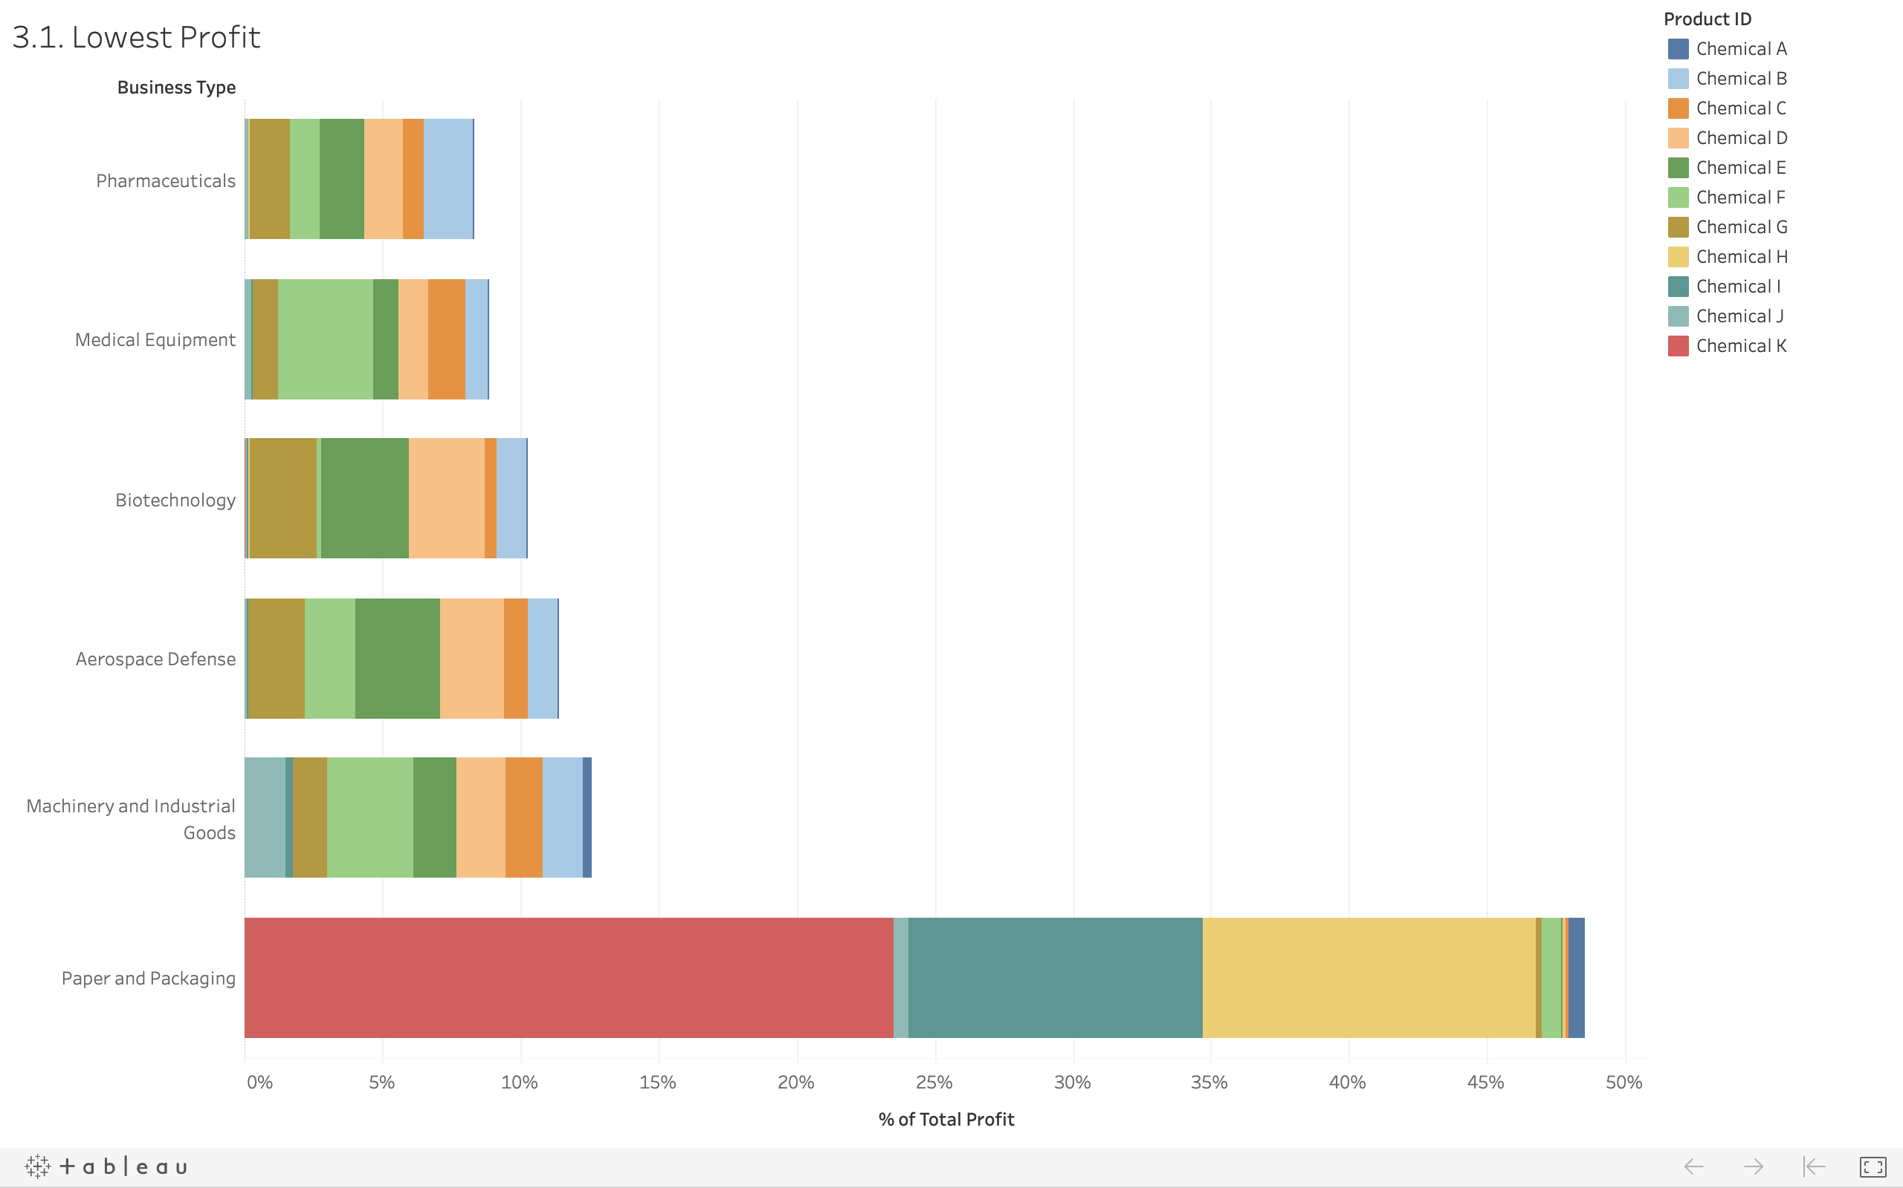
Paper and packaging are the most profitable area, while pharmaceutical is the worst.

Slide 6
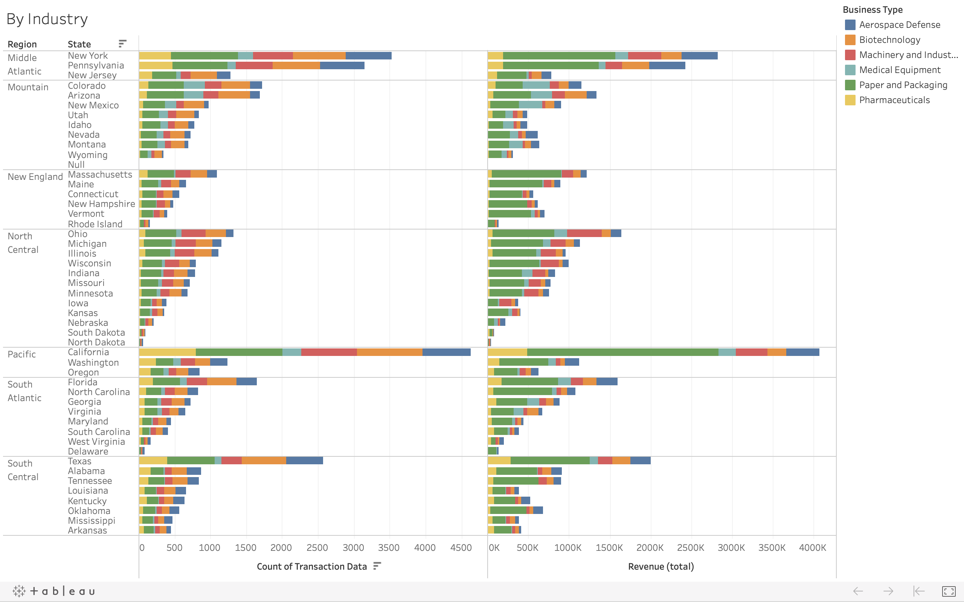
California is a leading state in terms of revenue. It is followed by New York and Pennsylvania.

Slide 7
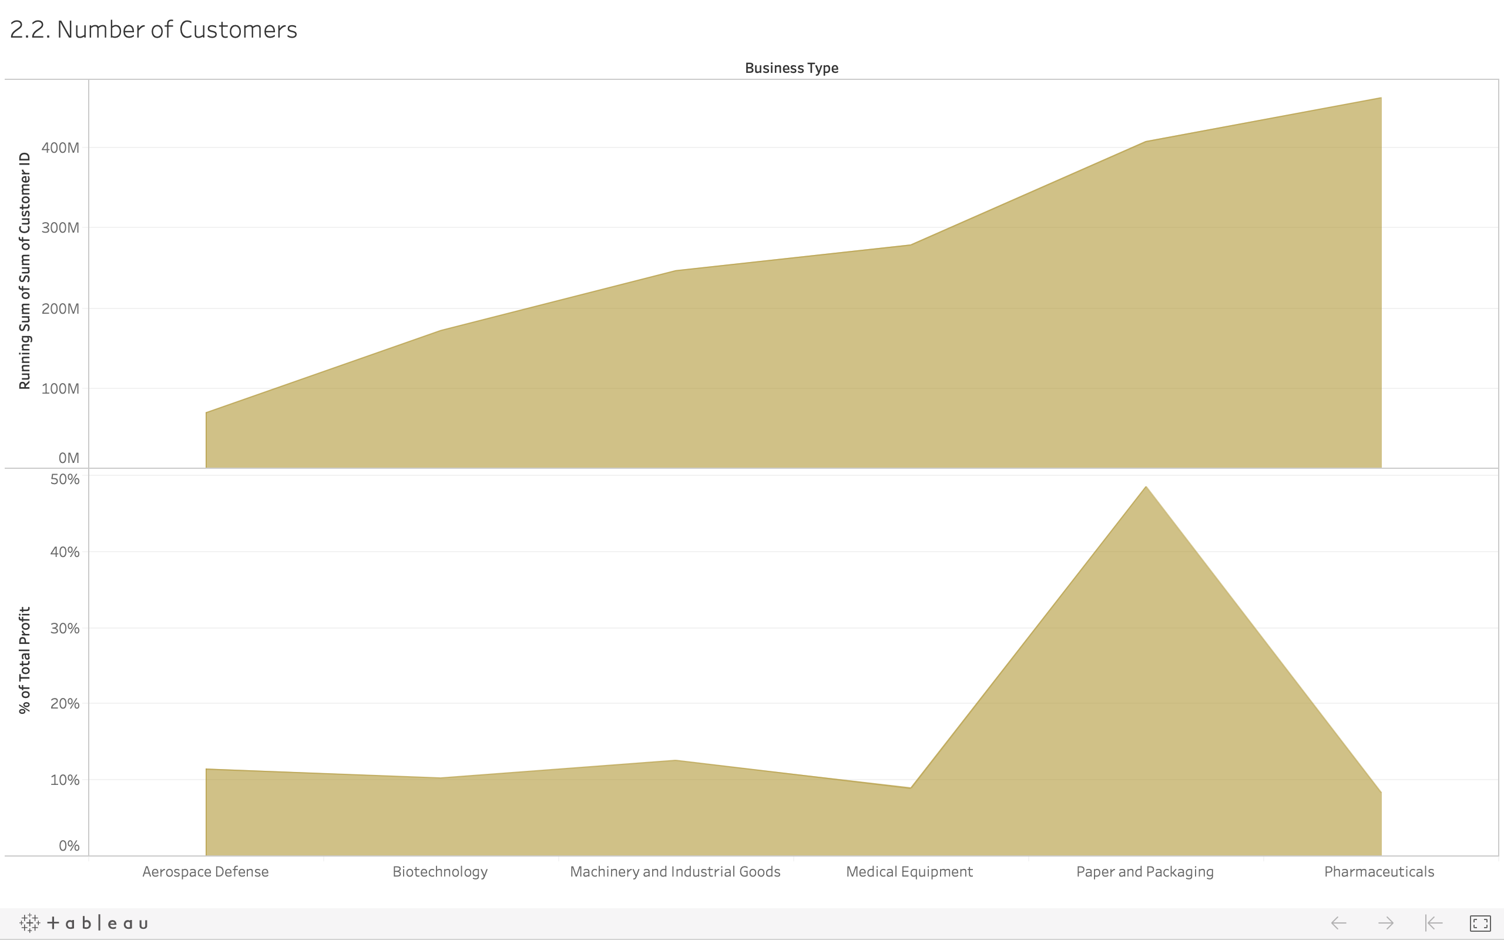
Even though Pharmaceuticals have the highest customer numbers, their profit margin is meager.

Slide 8
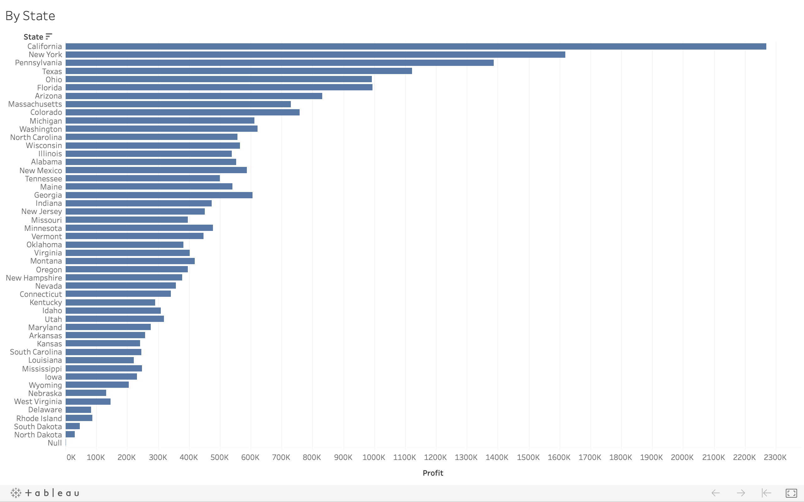
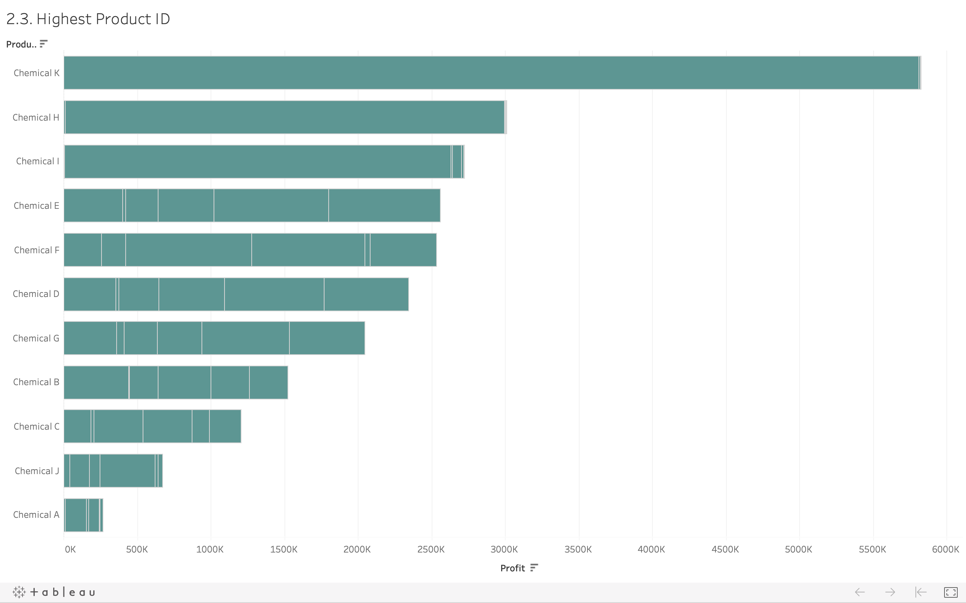
California by state and Chemical K by-product is the number one profitable.

Slide 9
Forecasting data shows that the cost margin will remain the same if it doesn’t take precaution to reduce it.

